Slide 1
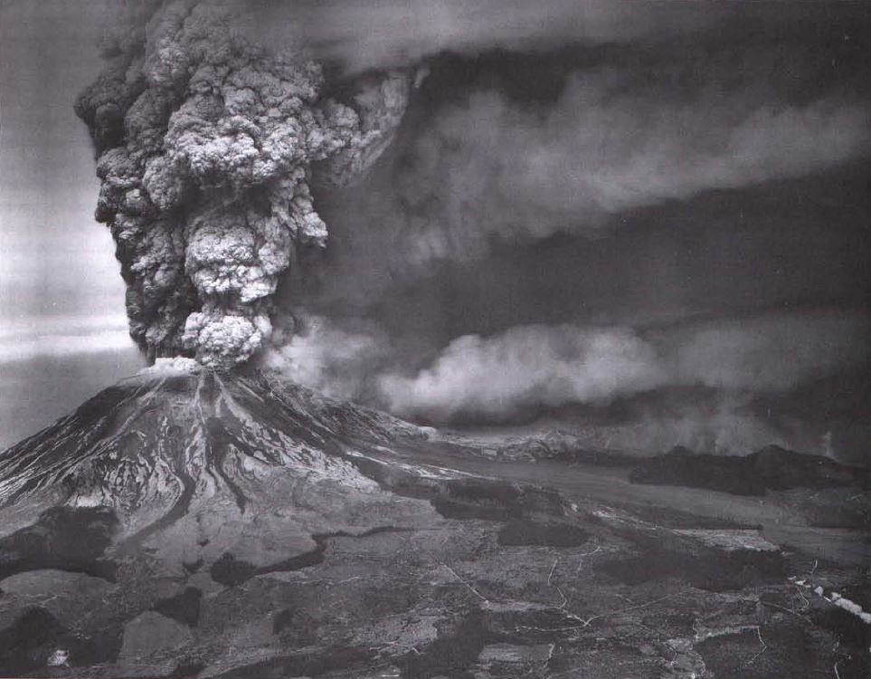
Quaternary Tephrochronology Chapter 5 of Quaternary Nonglacial Geology: Conterminous U.S. (Vol. K-2) Andrei M. Sarna-Wojcicki – Branch of Western Regional Geology, USGS Jonathan O. Davis – DRI, UNR Presentation by James McNeil

Slide 2
Introduction
Tephrochronology – the study of tephra layers using volcanic ash beds and tuffs in order to correlate and date sediments, rocks, and structures
Stratigraphic and age control – regional tectonics
Determine physical and chemical properties of tephra material and evidence of eruptive style
Determine erupted sources of tephra and frequency of eruptions – volcanic hazard
Age control in studies of human history – anthropology and archaeology

Slide 3
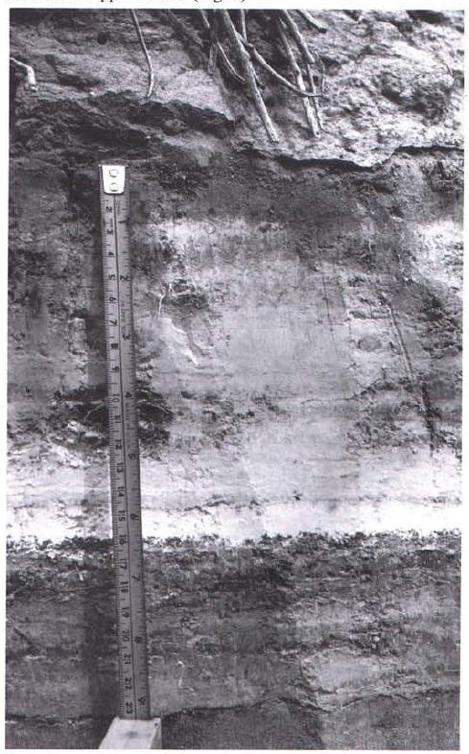
Tephra
Tephra – pyroclastic material erupted from a volcanic vent
Relates to the composition & physical and chemical characteristics of the tephra material
Morphology of glass shards and abundances of mineral species have similar properties genetically to their volcanic source area
Tephra is concentrated at the base and grades up to a mixture of tephra and increased sediment

Slide 4
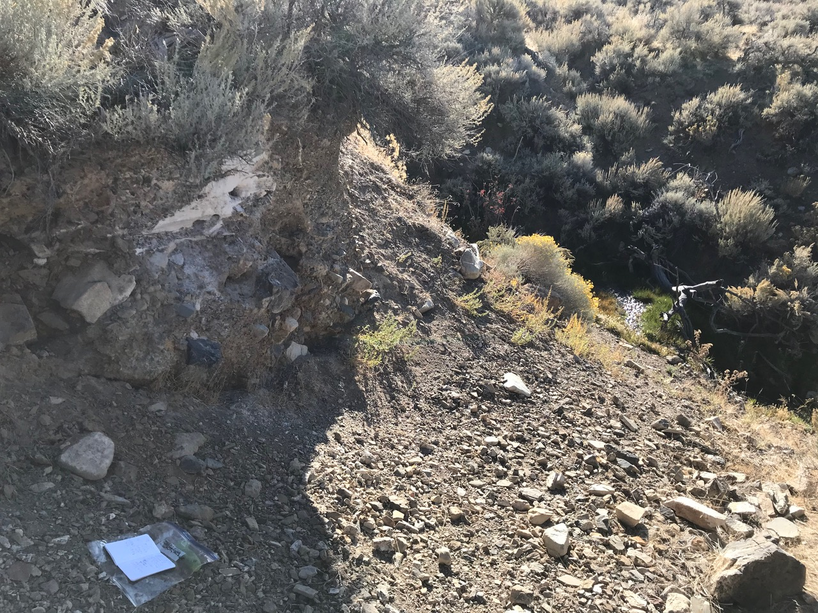
Tephra

Slide 5
Tephra

Slide 6
Composition of Tephra Layers
Pumice – solidified rock froth made of volcanic glass plus any of the following materials
Glass shards – exploded rock froth from bubble walls and bubble-wall junctions
Crystalline minerals and crystal fragments – minerals that crystallized before the eruption
Lithic fragments – sub-millimeter to > meter blocks of exploded solid roof material
Other materials – may include clastic, bioclastic, and organic sediments, and chemical precipitates

Slide 7
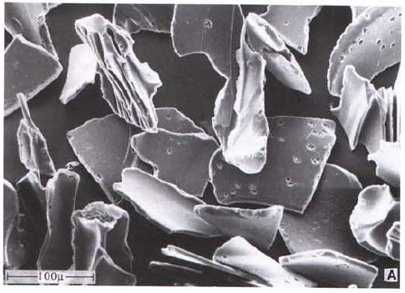
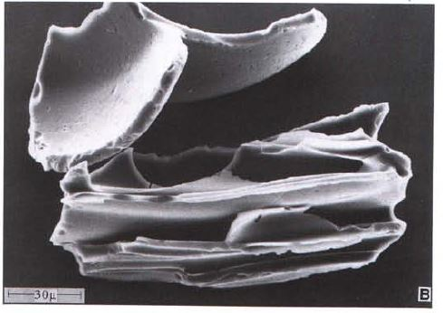
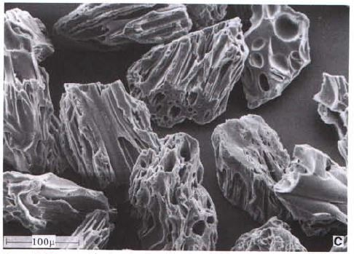
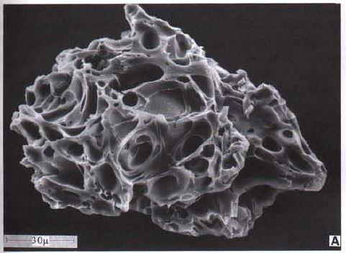
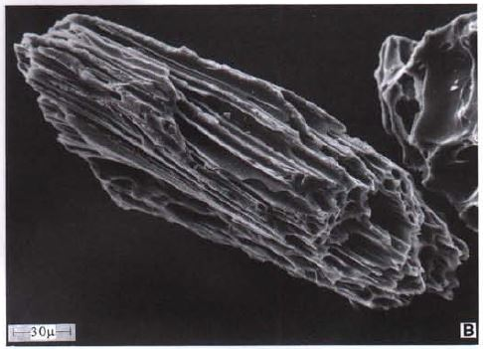
Plinean Eruptions - SEM Images
Lava Creek B ash bed - Yellowstone
Pumiceous shards Mount St. Helens
May 18, 1980

Slide 8
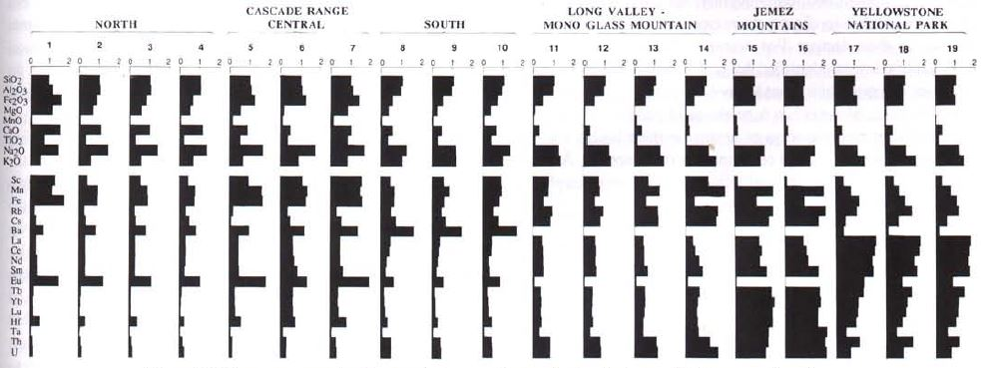
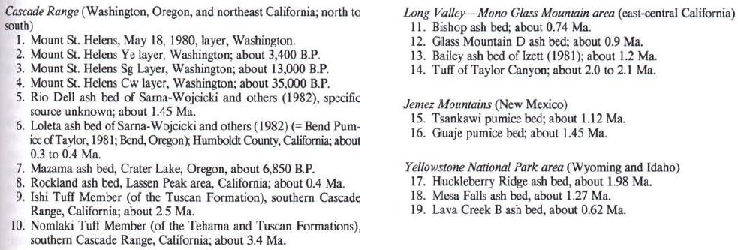
Composition of Tephra Layers
Electron microprobe analysis (EMA) – only major and a few minor elements for chemical characterization
X-ray fluorescence analysis (XRF) – minor and trace elements in glass
Instrumental neutron activation (INA) – 40 major, minor, and trace elements (20 useful in correlation of silicic glasses)

Slide 9
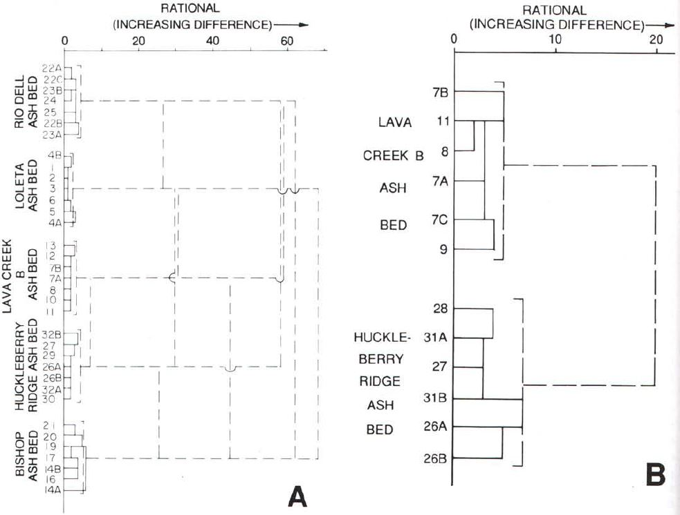
Methods of Correlation
K-Ar analysis
Laser-fusion Ar/Ar potassium-argon analysis
Fission-track dating of zircons and glass shards of tephra layers
Other direct (hydration, thermoluminescence, magnetostratigraphy) and indirect methods (radiocarbon, electron-spin resonance, amino-acid racemization, uranium series and uranium trend, ice core stratigraphy, dendrochronolgy, and written and oral history)
Dendrogram A –relation between compositions of sample pairs and sample groups of volcanic glasses based on EMA
Dendrogram B – relation between sample pairs of Yellowstone eruptions using IRA
Low RATIONAL value corresponds to similarity between material

Slide 10
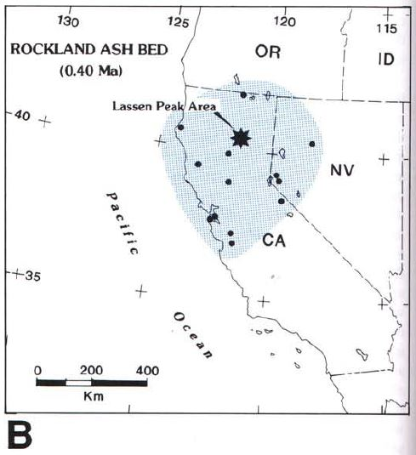
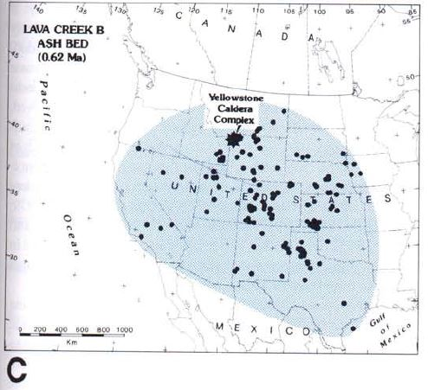
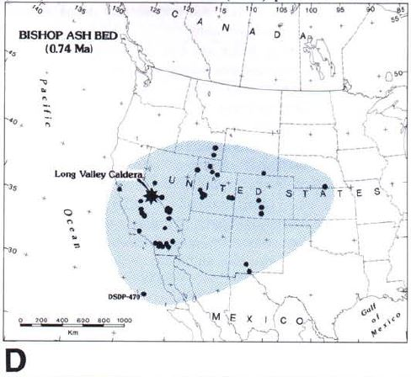
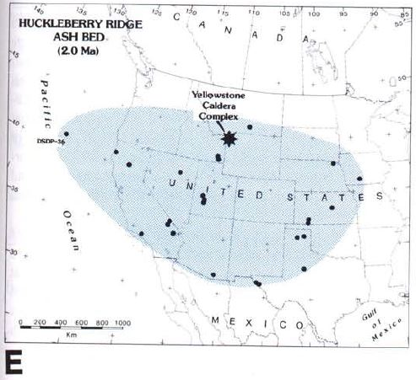
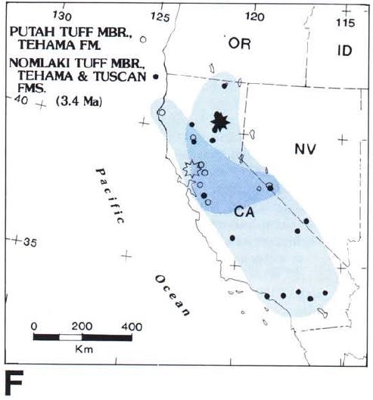
Eruptions – Source, Age, Distribution
Volcanism in the west accompanies subduction, transform faulting, extension, and hot spots

Slide 11
Mazama Ash Bed (6850 yr B.P.)
Consists of as many as 5 lobes
Important marker for lower Holocene deposits in NW U.S.

Slide 12
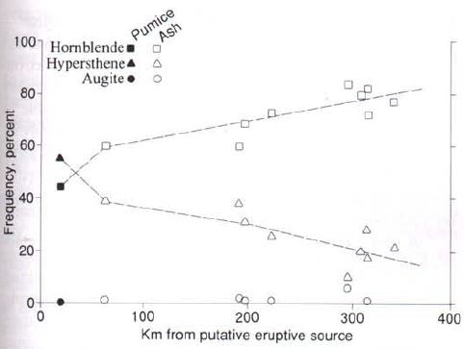
Rockland Ash Bed (0.40 Ma)
Important marker for upper Quaternary deposits
Hornblende becomes enriched with distance from source – mineral grains transported by wind or water
Near Lassen Peak

Slide 13
Bishop Ash Bed (0.74 Ma) and Lava Creek B Ash Bed (0.62 Ma)
Key time-stratigraphic markers for middle Quaternary continental and marine sequences

Slide 14
Huckleberry Ridge Ash Bed (2.0 Ma)
Important chronostratigraphic marker for upper Pliocene and lower Quaternary sections in the U.S.
History of misnaming and miscorrelating this tephra layer

Slide 15
Eruptions – Source, Age, Distribution
Provide age control for the upper Pliocene stratigraphic and structural framework of Quaternary deposits in the western U.S.

Slide 16
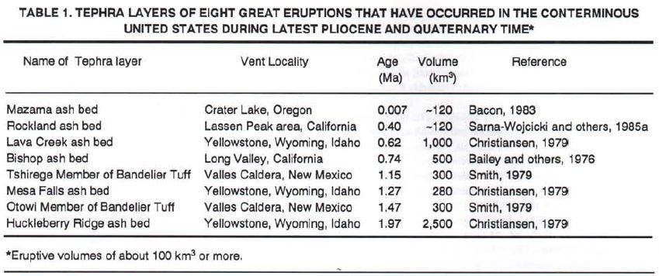
Conclusions
Take-home point: At least 8 major volcanic eruptions producing > 100 km³ of tephra as key time and stratigraphic horizons in the last ~2 m.y.
Also important for climatic and ecological effects of large eruptions.

